Slide 1

Dr. Najeed Ahmed Khan
Area of specialization: Artificial Intelligence Computer Vision
Email: najeed@hotmail.com
Department of Computer Science & IT
NED University of Engineering & Technology

Slide 2
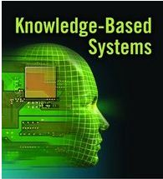
We are here to learn
CT-524
Knowledge Based System

Slide 3
Course
Thursday
1800 – 2100 hrs.
Grading
Sessional 40%
– Assignment / Project, Quizzes, Attendance
Final 60%

Slide 4
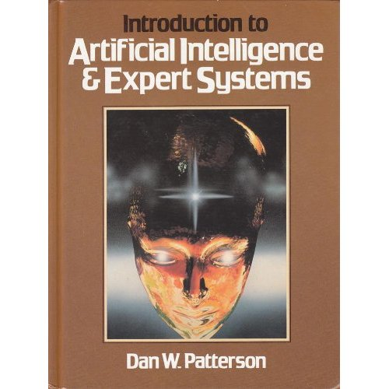
Textbook(s)
Introduction to
Artificial Intelligence And Expert Systems
DAN W. PATTERNSON
Readings from the text
Recommended strongly

Slide 5
Online Resources
My Knowledge based system home page(under work)
- Lecture Slides and other related material https://sites.google.com/site/CT524 Knowledge based/
Online texts and software
http://www.wtec.org/loyola/kb/c1_s1.htm
http://expertise2go.com/webesie/e2gdoc/
http://www.wtec.org/loyola/kb/c3_s2.htm

Slide 6
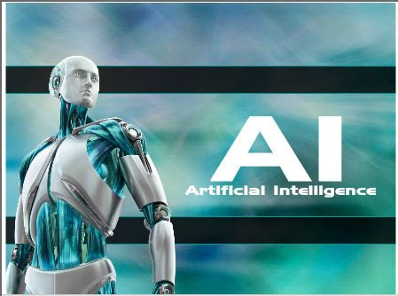
Introduction to
Our attempt to build Models of ourselves
(Elaine Rich)

Slide 7
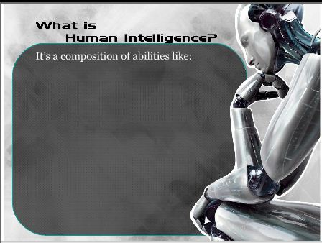

Slide 8
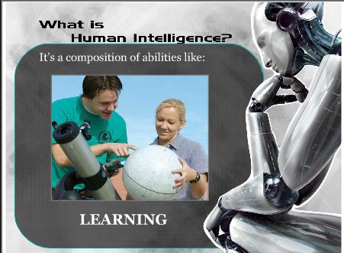

Slide 9
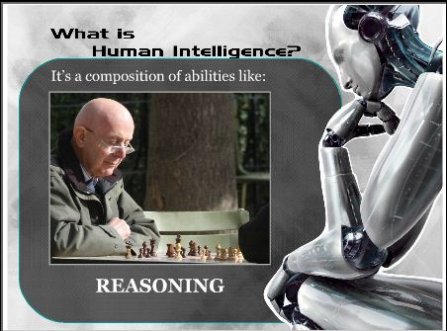

Slide 10
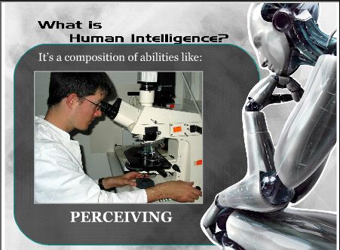

Slide 11
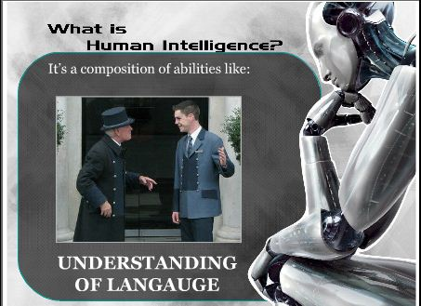

Slide 12
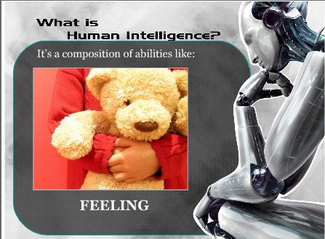

Slide 13
What is human intelligence (Cont)
–Learn from experience
–Apply knowledge acquired from experience
–Handle complex situations
–Solve problems when important information is missing
–Determine what is important
–React quickly and correctly to a new situation
–Understand visual images
–Process and manipulate symbols
–Be creative and imaginative
–Use heuristics

Slide 14
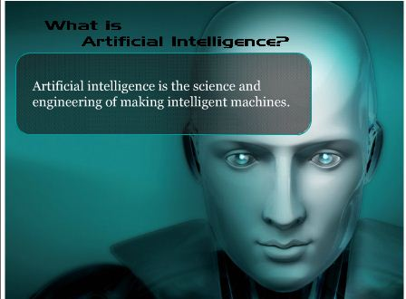

Slide 15
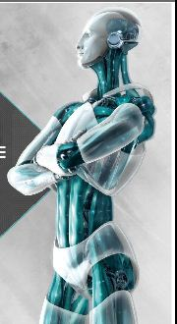
Applications of AI

Slide 16
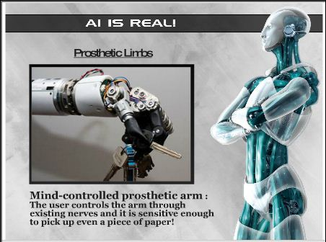
Applications of AI

Slide 17
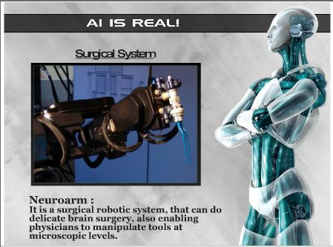
Applications of AI

Slide 18
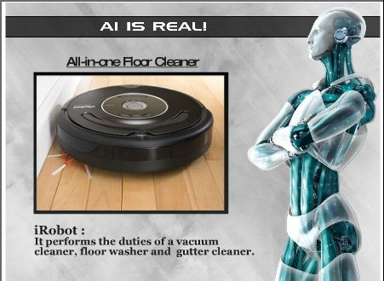
Applications of AI

Slide 19
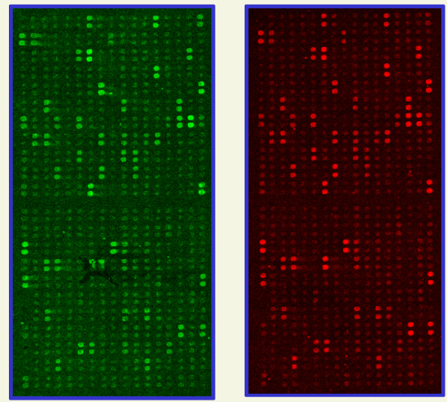
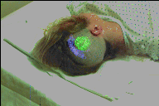
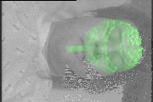
Applications of AI : Medicine/Genetics
• Diagnosis
– radiology - read X rays, CAT scans
– pathology - read biopsies
• Remote and tele-medicine
• Virtual reality surgical assistance
– project images onto head during brain surgery
• Genetics: microarray analysis

Slide 20
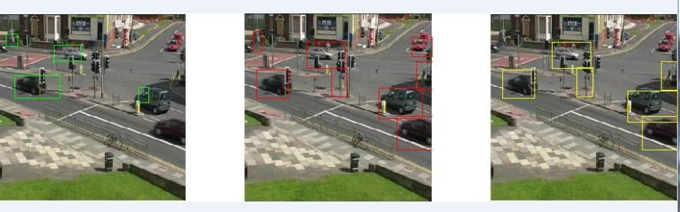
Applications of AI Transportation
• Traffic safety and control
– detection and ticketing of speeding vehicles
– vehicle counting for flow control’
• Robot drivers

Slide 21
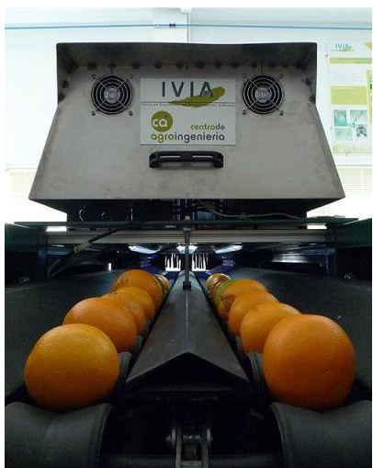
Applications of AI Agriculture
Safety and quality inspection
– sorting by size - Oranges
– sorting by shape - potatoes
– identifying defects:
blemishes on fruit, rot in
potatoes
– disease monitoring - chickens

Slide 22
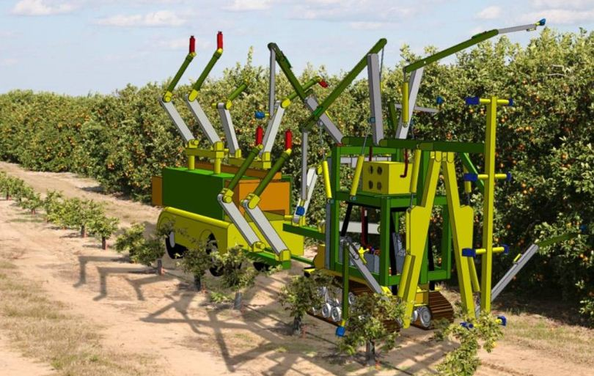
Applications of AI Vision robotics a company in California
• Robotic farming equipment
– robotic harvesters - apple pickers, orange, pickers

Slide 23
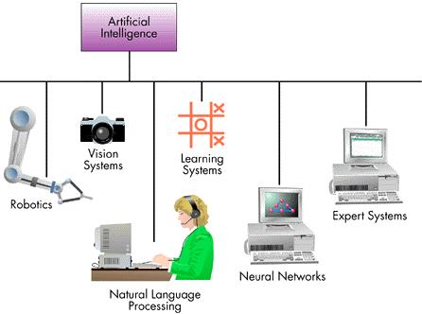
Major Branches of A. I.

Slide 24

Robotics Mechanical and computer devices that performs tedious tasks with high precision.

Slide 25

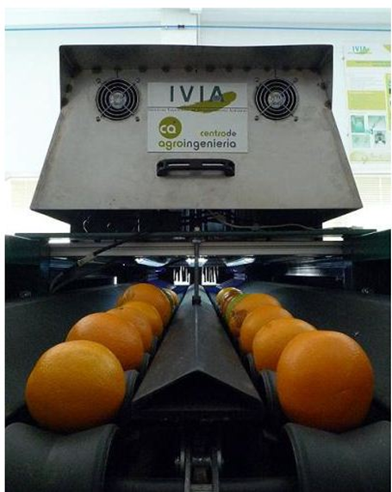
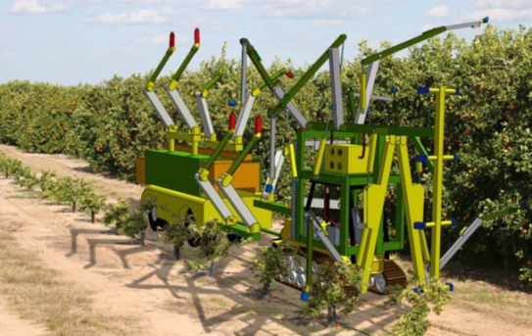
Vision system
Capture, store, and manipulate visual images and pictures

Slide 26
Natural Language Processing
Computers understand and react to statements and commands made in a “natural” language, such as English.
e.g. Windows 7 OS supports speech recognition

Slide 27
Learning System
Computer changes how it functions or reacts to situations based on feedback.
e.g. Automatic intelligent door system
Intelligent fire alarms

Slide 28
Expert System/Knowledge based system
Stores knowledge and makes inferences.
e.g. Eliza (ES)
H: Men are all alike
E: In what way?
H: They’re always bugging us about something or another.
E: Can you be more specific?
H: Well, my boyfriend made me come here.
E: Your boyfriend made you come here?
H: He says I’m depressed much of the time.
E: I am sorry to hear you are depressed.
H: It’s true. I am unhappy.
E: Do you think coming here will help you not to be unhappy?
H: I need some help, that much seems certain.
E: What would it mean to you if you got some help?
H: Perhaps I could learn to get along with my mother.
E: Tell me more about your family

Slide 29
Knowledge based system (Introduction)
The name Expert Systems was derived from the term knowledge-base expert systems.
An ES is a system that employs human knowledge captured in a computer to solve problems.

